Slide 1
Hello Nextflow
Code introduction: workflow & process

Slide 2
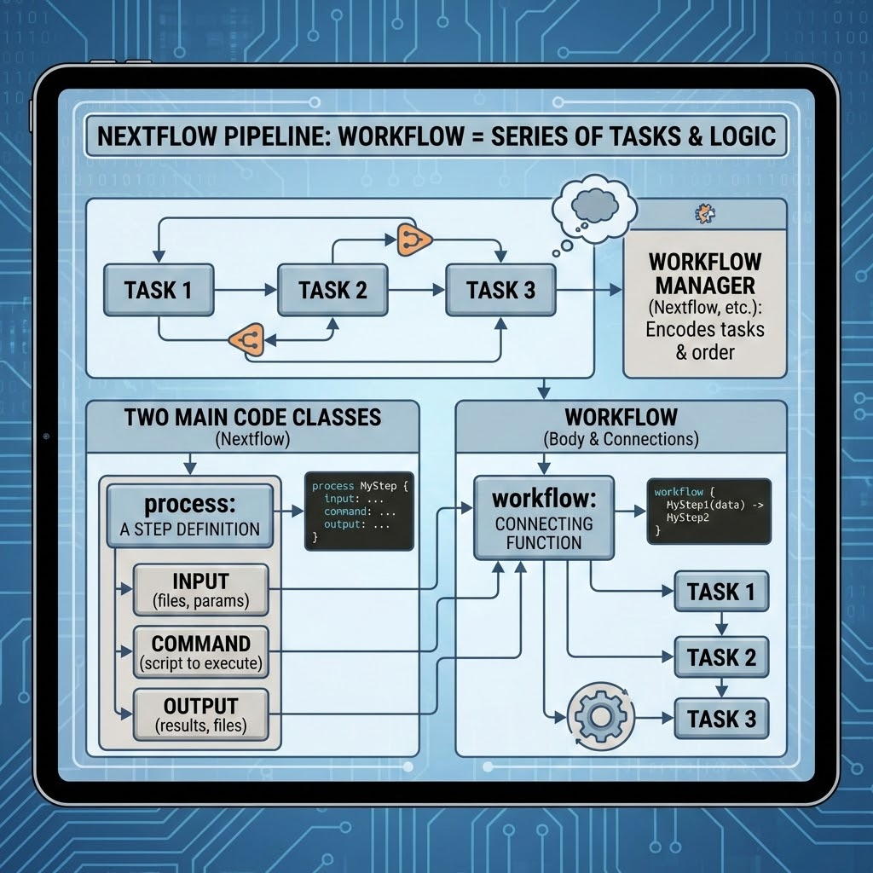
Key components of a Nextflow pipeline
A workflow is a series of “tasks” to be carried out in a specific order and with pre-defined logics
Every workflow manager (Nextflow, SnakeMake etc.) have its own way of encoding the different tasks to be carried out until the end of the analysis
In Nextflow you have two main code classes to build your very first pipeline
process: the definition of a step, minimally composed by input, output and command to execute
workflow: body where to write the functions to connect different processes

Slide 3
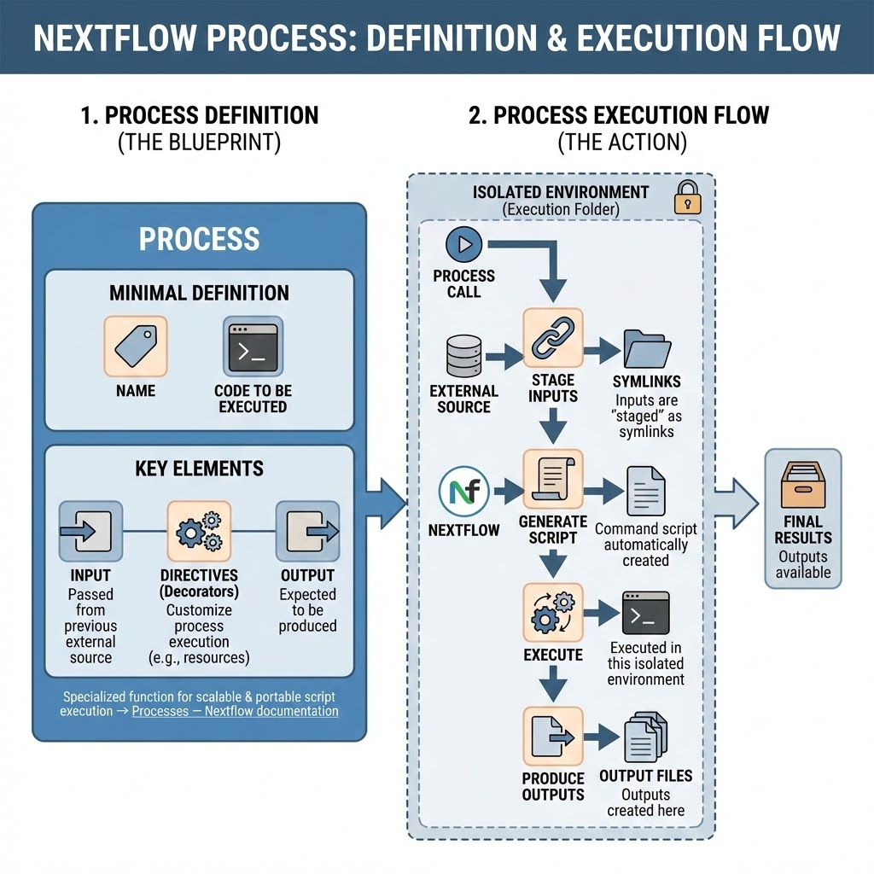
Key components and principles of a process
A process is a specialized function for executing scripts in a scalable and portable manner → Processes — Nextflow documentation
The very minimal definition include a name and a code to be executed, but generally it is needed to define other elements:
input: elements that are passed to the process from a previous external source
output: elements that are expected to be produced from the process
decorators: additional objects, in Nextflow are called “directives”, used to customize the process in many different ways
A each time a process is called is executed into an isolated environment
Inputs are “staged” into a specific execution folder, generally as symlinks
The process command is written in a script automatically created by Nextflow
The process is executed in this isolated environment, so the outputs will be created there

Slide 4
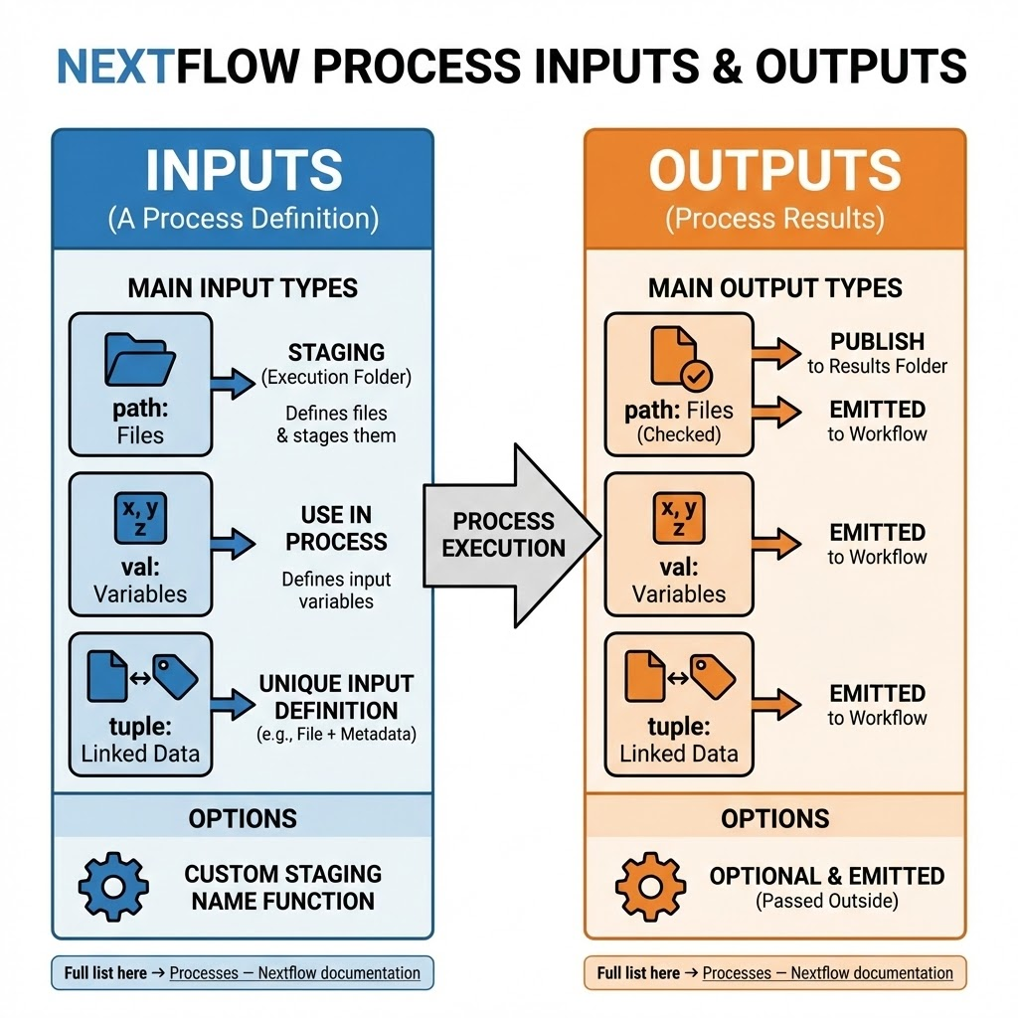
Input & output process definitions
A process can have a number (as much as you like) number of inputs that can be defined in many different ways; the most important are:
path: used to define input files and staging them correctly in the in execution folder
val: used to define input variables and use them in your process
tuple: used to put together multiple of the previous in a unique input definition → for example to link together files and metadata associated to that file
Full list here → Processes — Nextflow documentation
As for the inputs, the same apply to outputs → you can define as much outputs as you want as path, val or tuple ()
The existence of output files (e.g. the one defined by path) are generally checked every time a given process is executed
Defined output files can be published them to the results folder
Full list here → Processes — Nextflow documentation
Each input/output definition may have a series of options related to them
Input files (e.g. when you declare them with path) can have a custom staging name function
Output files can be defined as optional and/or be “emitted” as previously so that they can be passed outside the process to your workflow

Slide 5
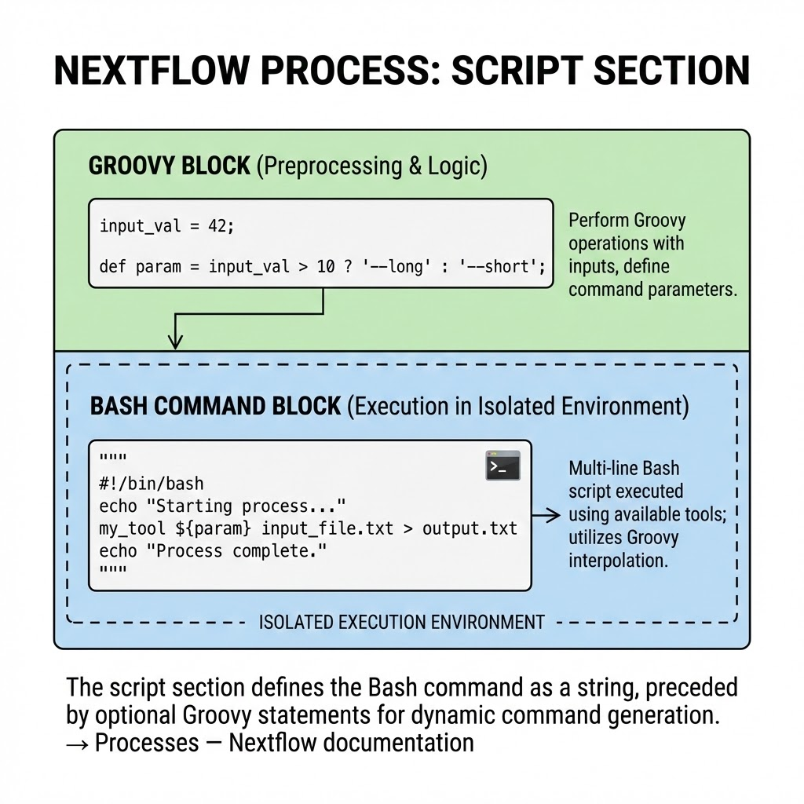
Command definition: the “script” section
In the script section you can define, as a string, the Bash command to execute for a given process → Processes — Nextflow documentation
The command is executed in the isolated environment, so it will use the commands and tools available in that given environment
This string can be also multi-line, so that you can write it down as any Bash script you would normally write
This string can be preceded by any Groovy statement where you can perform any Groovy operation with the defined input → for example you can define specific command parameters given specific values passed to val and pass them to the command string using interpolation

Slide 6
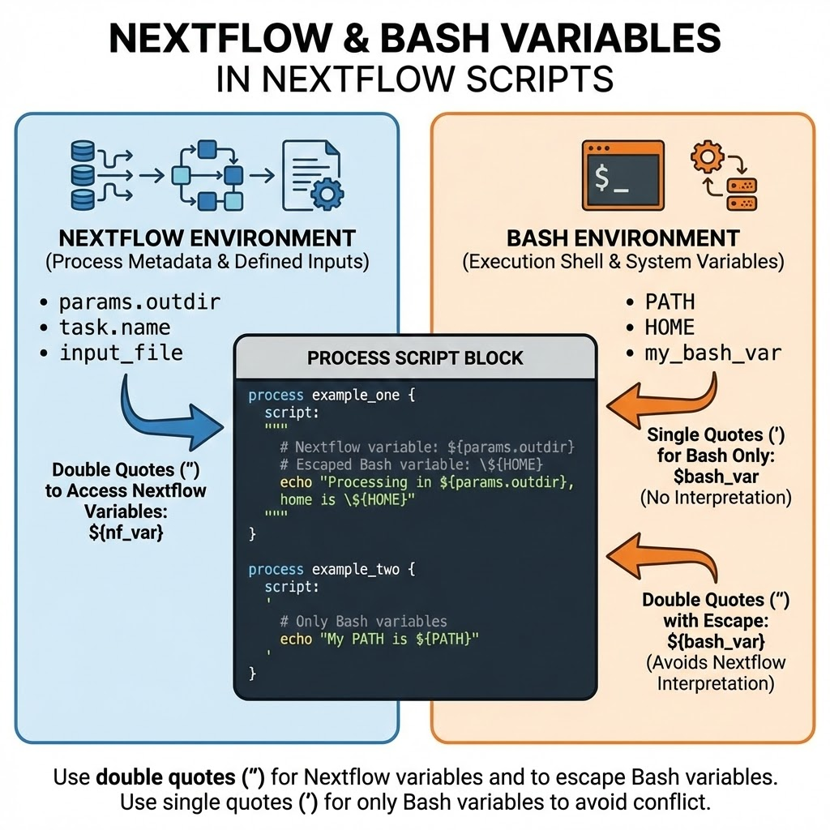
Nextflow and Bash variables in the process
When writing a process, remember that you have “two environments” in the same place instance with their own environmental variables:
Nextflow: defined input, process metadata (for example the process name)
Bash: anything you would define during the process or general variables such as ${PATH}
If you don’t need any Nextflow variable, you can use single quotes (‘) to call Bash variables as they are (e.g. $my_var)
If you need to access Nextflow variables, then you need to use double quotes (“) and to escape Bash variables (e.g. \${my_var}) because the Nextflow variables are called with the usual $ notation (e.g. ${my_nf_var}, \${my_bash_var})

Slide 7
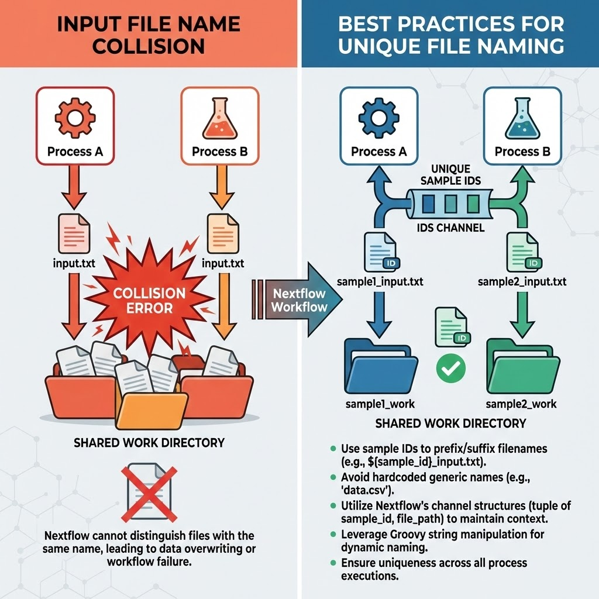
Input file name collision
Whenever you have a job that takes multiple files as input, each one of these must have a unique name
Since every task is executed in an isolated environment and since the input files are staged TOGETHER in a single folder, if you have files that have the same name Nextflow will fail
To avoid this error, find a “unique ID” to name your time for each task
For example, if you need to execute a task by sample, you could name your file ${sample}.txt
You can apply this reasoning for every combination of variables that uniquely define a task execution
If you have a task that you know it will be executed only once, you don’t need to worry about this and you can use a “flat” name for your file
To name your files, you can use metadata that you bring together with a file in your channel and access that metadata as a Nextflow variable in the script section

Slide 8
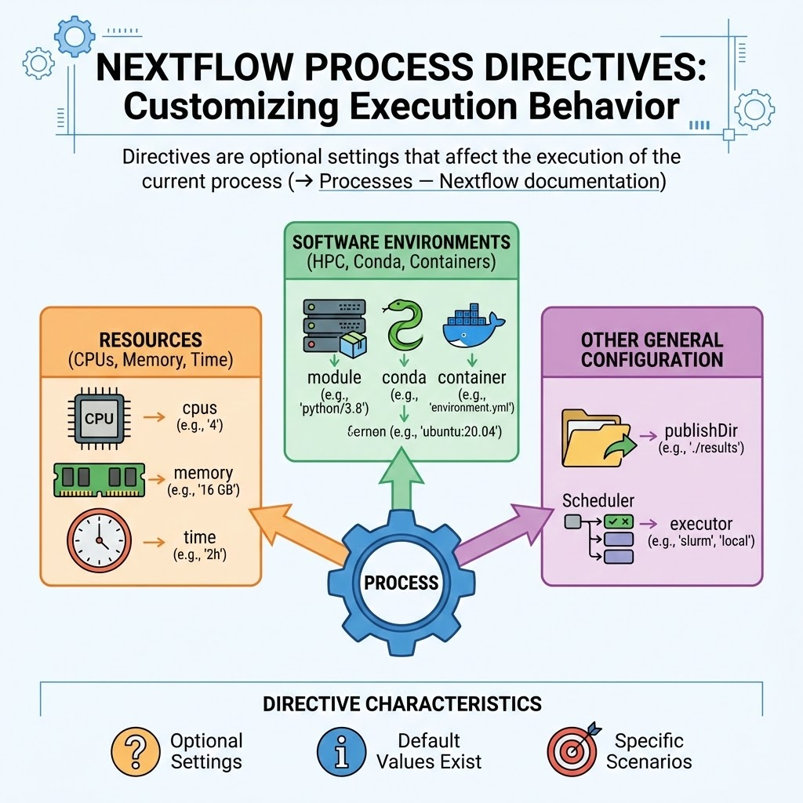
Decorators for your processes: directives
Directives are optional settings that affect the execution of the current process → Processes — Nextflow documentation
There are A LOT of different directives; some will have default values even if you don’t declare them while others are specific for given situation and will not be used in specific scenarios
Examples of executors can be related to:
Resources: CPUs, Memory or time to assign to each task execution
Software environments: HPC modules, conda environments, containers
Other general configuration
Publish files to a given output folder
Executor → which scheduler to use
Comprehensive documentation of all the directives → Process reference — Nextflow documentation

Slide 9
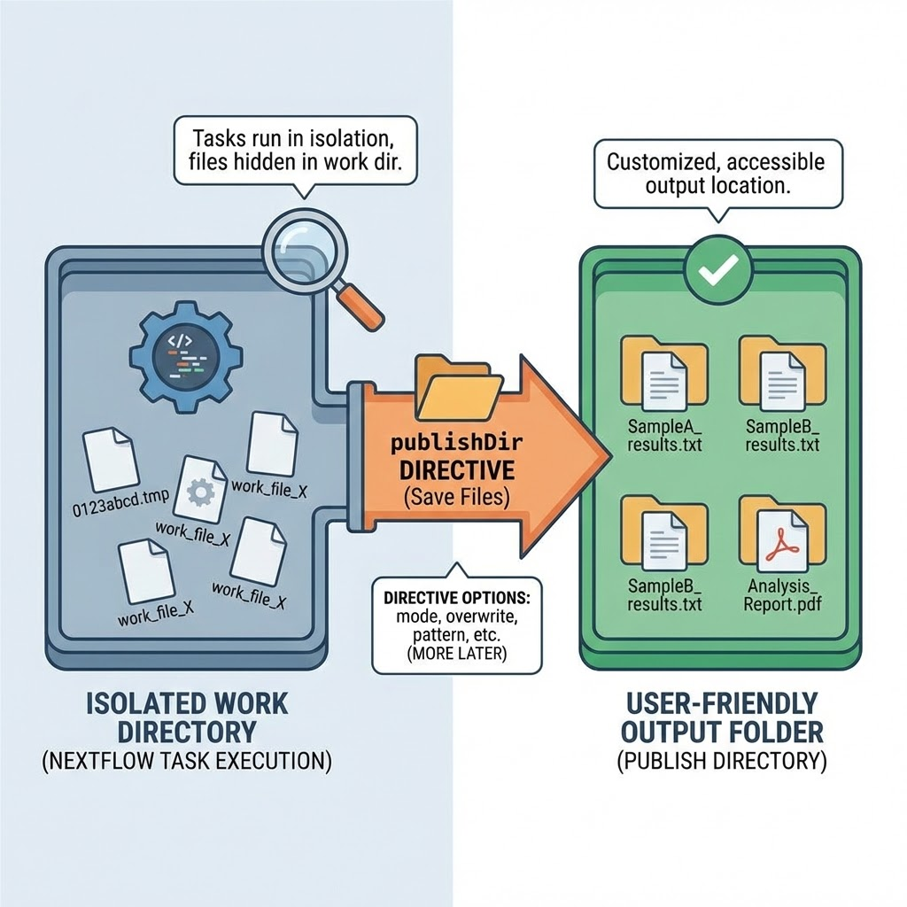
publishDir directive for publishing files to your output folder
As we said, tasks are executed in an isolated context and directory in the work space
If we want to save files from that isolated space to another location, we need to use the publishDir directive
With this we can define the output folder and customize where to put all the output files that we need in a user friendly manner, without looking for them in the work dir
The directive have multiple options associated to the path where to publish the files; one of these is mode
With mode you can control how a file is published from the work to the output directive
By default mode is symlink, so you will not copy the files to your output dir but you will symlink them
Symlinks allow you to save space but once you clean up your work folder your symlink will be broken
Copying files will temporarily occupy more space until you don’t clean up your work dir
publishDir complete reference: Process reference — Nextflow documentation
IMPORTANT: the copy of the files to the destination dir is asynchronous, meaning that the copy of the files doesn’t necessarily start when the output file is created
There may be an important number of files to copy, Nextflow will create a “queue to copy”
NEVER use the published files in your workflow → the copy can take time, the files will be corrupted during the copy

Slide 10
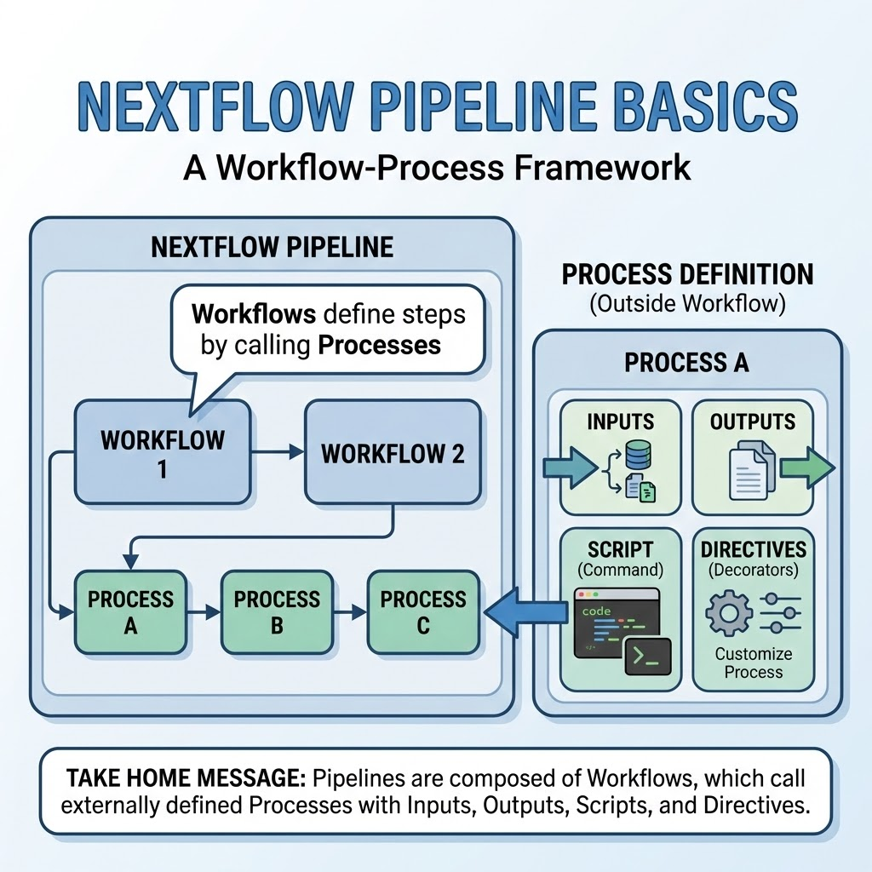
Recap and key points
Nextflow pipelines are composed by workflows
In workflows you can define the different steps using processes
The process is defined outside the workflow and then called inside the workflow
Processes are generally composed by different elements
Inputs
Outputs
Command to be executed (script)
Directives → decorators that can be used to customize the process

